Slide 1
Chapter 1
The Revolutionary Impact of Entrepreneurship

Slide 2


Entrepreneurs—Challenging the Unknown
Entrepreneurs
  Recognize opportunities where others see chaos or confusion
  Are aggressive catalysts for change within the marketplace
  Challenge the unknown and continuously create the future

Slide 3
Entrepreneurs versus
Small Business Owners: A Distinction
Small Businesses Owners
  Manage their businesses by expecting stable sales, profits, and growth
Entrepreneurs
  Focus their efforts on innovation, profitability and sustainable growth

Slide 4
Entrepreneurship: A Mindset
Entrepreneurship is more than the mere creation of business:
  Seeking opportunities
  Taking risks beyond security
  Having the tenacity to push an idea through to reality
Entrepreneurship is an integrated concept that permeates an individual’s business in an innovative manner.

Slide 5
The Evolution of Entrepreneurship
Entrepreneur is derived from the French entreprendre, meaning “to undertake.”
  The entrepreneur is one who undertakes to organize, manage, and assume the risks of a business.
  Although no single definition of entrepreneur exists and no one profile can represent today’s entrepreneur, research is providing an increasingly sharper focus on the subject.
© 2012 Cengage Learning. All rights reserved.

Slide 6
A Summary Description of Entrepreneurship
Entrepreneurship (Robert C. Ronstadt)
  The dynamic process of creating incremental wealth.
  This wealth is created by individuals who assume major risks in terms of equity, time, and/or career commitment of providing value for a product or service.
  The product or service itself may or may not be new or unique but the entrepreneur must somehow infuse value by securing and allocating the necessary skills and resources.
© 2012 Cengage Learning. All rights reserved.

Slide 7
An Integrated Definition
Entrepreneurship
  A dynamic process of vision, change, and creation.
    Requires an application of energy and passion towards the creation and implementation of new ideas and creative solutions.
  Essential ingredients include:
    The willingness to take calculated risks—in terms of time, equity, or career.
    The ability to formulate an effective venture team; the creative skill to marshal needed resources.
    The fundamental skills of building a solid business plan.
    The vision to recognize opportunity where others see chaos, contradiction, and confusion.
© 2012 Cengage Learning. All rights reserved.

Slide 8
The Myths of Entrepreneurship
Myth 1: Entrepreneurs Are Doers, Not Thinkers
Myth 2: Entrepreneurs Are Born, Not Made
Myth 3: Entrepreneurs Are Always Inventors
Myth 4: Entrepreneurs Are Academic and Social Misfits
Myth 5: Entrepreneurs Must Fit the “Profile”
Myth 6: All Entrepreneurs Need Is Money
Myth 7: All Entrepreneurs Need Is Luck
Myth 8: Ignorance Is Bliss For Entrepreneurs
Myth 9: Entrepreneurs Seek Success But Experience
High Failure Rates
Myth 10: Entrepreneurs Are Extreme Risk Takers (Gamblers)
© 2012 Cengage Learning. All rights reserved.

Slide 9
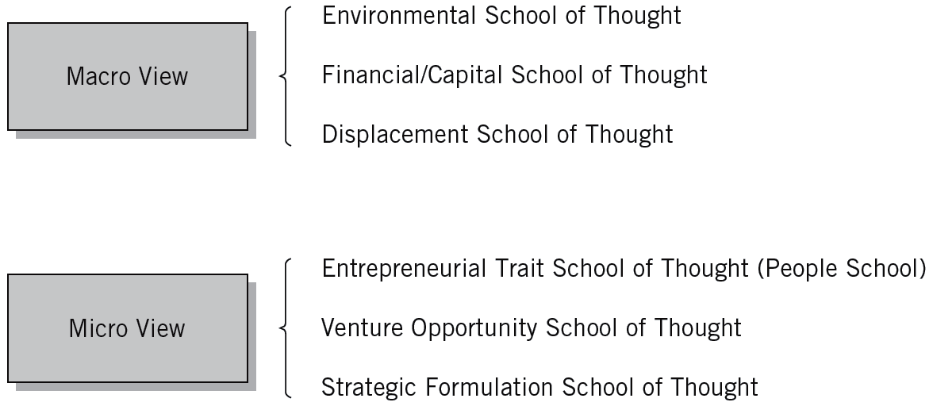
^{Figure} 1.1 Entrepreneurial Schools-of-Thought Approach
© 2012 Cengage Learning. All rights reserved.

Slide 10
Macro View: External Locus of Control
The Environmental School of Thought
  Considers the external factors that affect a potential entrepreneur’s lifestyle.
The Financial/Capital School of Thought
  Based on the capital-seeking process—the search for seed and growth capital.
The Displacement School of Thought
  Alienation drives entrepreneurial pursuits
    Political displacement (laws, policies, and regulations)
    Cultural displacement (preclusion of social groups)
    Economic displacement (economic variations)
© 2012 Cengage Learning. All rights reserved.

Slide 11

^{Table} 1.1 Financial Analysis Emphasis
Venture Stage | Financial Consideration | Decision
Start-up or acquisition | Seed capital Venture capital sources | Proceed or abandon
Ongoing | Cash management Investments Financial analysis and evaluation | Maintain, increase, or reduce size
Decline or succession | Profit question Corporate buyout Succession question | Sell, retire, or dissolve operations
© 2012 Cengage Learning. All rights reserved.

Slide 12
Micro View: Internal Locus of Control (cont’d)
The Entrepreneurial Trait School of Thought
  Focuses on identifying traits common to successful entrepreneurs.
    Achievement, creativity, determination, and technical knowledge
The Venture Opportunity School of Thought
  Focuses on the opportunity aspect of venture development—the search for idea sources, the development of concepts, and the implementation of venture opportunities.
    Corridor principle: New pathways or opportunities will arise that lead entrepreneurs in different directions.
© 2012 Cengage Learning. All rights reserved.

Slide 13
^{Table} 1.2 Definitions And Criteria Of One Approach To The Micro View
Entrepreneurial Model | Definition | Measures | Questions
“Great Person” | “Extraordinary Achievers” | Personal principles Personal histories Experiences | What principles do you have? What are your achievements?
Psychological Characteristics | Founder Control over the means of production | Locus of control Tolerance of ambiguity Need for achievement | What are your values?
Classical | People who make innovations bearing risk and uncertainty “Creative destruction” | Decision making Ability to see opportunities Creativity | What are the opportunities? What is your vision? How do you respond?
Management | Creating value through the recognition of business opportunity, the management of risk taking . . . through the communicative and management skills to mobilize . . . | Expertise Technical knowledge Technical plans | What are your plans? What are your capabilities? What are your credentials?
Leadership | “Social architect” Promotion and protection of values | Attitudes, styles Management of people | How do you manage people?
Intrapreneurship | Those who pull together to promote innovation | Decision making | How do you change and adapt?
Source: Adapted from J. Barton Cunningham and Joe Lischeron, “Defining Entrepreneurship,” Journal of Small Business Management (January 1991): 56.
© 2012 Cengage Learning. All rights reserved.

Slide 14
Micro View… (cont’d)
The Strategic Formulation School of Thought
  Emphasizes the planning process in successful venture development.
Ronstadt’s View
  Strategic formulation is a leveraging of unique elements:
    Unique Markets—mountain gap strategies
    Unique People—great chef strategies
    Unique Products—better widget strategies
    Unique Resources—water well strategies
© 2012 Cengage Learning. All rights reserved.

Slide 15
Process Approaches to Entrepreneurship
Integrative Approach
  Built around the concepts of inputs to the entrepreneurial process and outcomes from the entrepreneurial process.
  Focuses on the entrepreneurial process itself and identifies five key elements that contribute to the process.
  Provides a comprehensive picture regarding the nature of entrepreneurship that can be applied at different levels.
© 2012 Cengage Learning. All rights reserved.

Slide 16
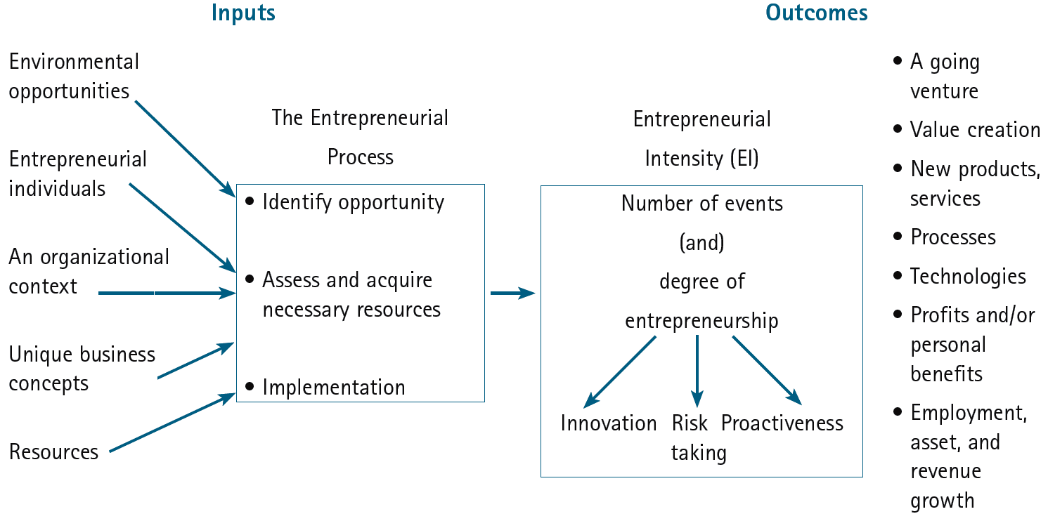
^{Figure} 1.2 An Integrative Model of Entrepreneurial Inputs and Outcomes
Source: Michael H. Morris, P. Lewis, and Donald L. Sexton, “Reconceptualizing Entrepreneurship: An Input-Output Perspective,” SAM Advanced Management Journal 59, no.1 (Winter 1994): 21–31.
© 2012 Cengage Learning. All rights reserved.

Slide 17
Process Approaches… (cont’d)
Entrepreneurial Assessment Approach
  Stresses making assessments qualitatively, quantitatively, strategically, and ethically in regard to the entrepreneur, the venture, and the environment
Multidimensional Approach
  Views entrepreneurship as a complex, multidimensional framework that emphasizes the individual, the environment, the organization, and the venture process.
© 2012 Cengage Learning. All rights reserved.

Slide 18
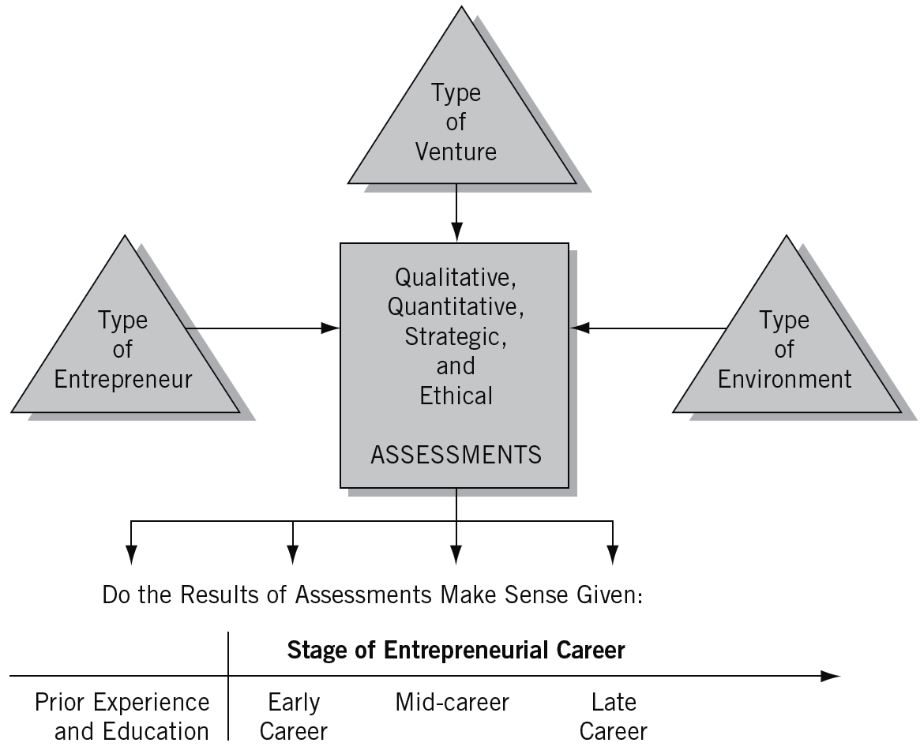
^{Figure} 1.3 Entrepreneurial Assessment Approach
Source: Robert C. Ronstadt, Entrepreneurship (Dover, MA: Lord Publishing Co., 1984), 39.
© 2012 Cengage Learning. All rights reserved.

Slide 19
Our Entrepreneurial Economy—
The Environment for Entrepreneurship
Entrepreneurship is the symbol of business tenacity and achievement.
Entrepreneurs are the pioneers of today’s business successes.
Two perspectives on entrepreneurship:
  Statistical: numbers that emphasize the importance of entrepreneurs to the economy.
  Academic: trends in entrepreneurial research and education.
© 2012 Cengage Learning. All rights reserved.

Slide 20
Predominance of New Ventures in the Economy
Entrepreneurial Activity: Growth in Small Businesses
  New business incorporations average 600,000 per year over the past decade.
  There are over 25 million small businesses; the number continues to grow 2% annually.
  One of every 150 adults participates in the founding of a new firm each year.
  Approximately 600,000 to 800,000 are added each year.
© 2012 Cengage Learning. All rights reserved.

Slide 21
Effects of Entrepreneurship
The Global Entrepreneurship Monitor (GEM)
  Provides an annual assessment of the entrepreneurial environment of 42 countries.
  Latest GEM study: the U.S. outranks the rest of the world in important entrepreneurial support.
Entrepreneurs lead to growth by:
  Entering and expanding existing markets.
  Creating entirely new markets by offering innovative products.
  Increasing diversity and fostering minority participation in the economy.
© 2012 Cengage Learning. All rights reserved.

Slide 22
Entrepreneurs in the United States
Reasons for the exceptional entrepreneurial activity in the U.S. include:
  A national culture that supports risk taking and seeking opportunities.
  Americans’ alertness to unexploited economic opportunity and a low fear of failure.
  U.S. leadership in entrepreneurship education at both the undergraduate and graduate level.
  A high percentage of individuals with professional, technological or business degrees who are likely to become entrepreneurs.
© 2012 Cengage Learning. All rights reserved.

Slide 23
The Age of Gazelles
A “Gazelle”
  A business establishment with at least 20% sales growth in each year for five years, starting with a base of at least $100,000 in annual sales.
Gazelles as leaders in innovation:
  Produce twice as many product innovations per employee as do larger firms.
  Have been responsible for 55% of the innovations in 362 different industries and 95% of all radical innovations.
  Obtain more patents per sales dollar than do larger firms.
© 2012 Cengage Learning. All rights reserved.

Slide 24
^{Table} 1.3 Mythology Associated with Gazelles
Gazelles are the goal of all entrepreneurs.
Gazelles receive venture capital.
Gazelles were never mice.
Gazelles are high-tech.
Gazelles are global.
Source: NFIB Small Business Policy Guide (Washington, D.C., November 2000), 31.
© 2012 Cengage Learning. All rights reserved.

Slide 25
Survival of Gazelles
How many gazelles survive?
  The simple answer is “none.” Sooner or later, all companies wither and die.
The Common Myth of Failure:
  85% of all firms fail in the first year—in actuality, about half of all start-ups last between 5 and 7 years.
© 2012 Cengage Learning. All rights reserved.

Slide 26
Entrepreneurial Firms’ Impact
Entrepreneurial components of the U.S. Economy:
  Large firms have increased profitability by returning to their “core competencies through restructuring and downsizing.
  New entrepreneurial companies have been blossoming in new technologies and new markets.
  Thousands of smaller firms established by women, minorities, and immigrants have strengthened the economy.
© 2012 Cengage Learning. All rights reserved.

Slide 27
Entrepreneurial Firms’ Impact Cont’d)
Entrepreneurial firms make two indispensable contributions to an economy:
  They are an integral part of the renewal process that pervades and defines market economies.
  They are the essential mechanism by which millions enter the economic and social mainstream of society.
© 2012 Cengage Learning. All rights reserved.

Slide 28


21st Century Trends in Entrepreneurship Research
Venture
Financing
Corporate Entrepreneurship
Social Entrepreneurship
Trends in Entrepreneurship Research
Entrepreneurial Cognition
Women
and Minority Entrepreneurs
Global Entrepreneurial Movement
Entrepreneurial Education
Family
Businesses
© 2012 Cengage Learning. All rights reserved.

Slide 29
21st Century Trends in Entrepreneurship Research
Major Research Themes:
  Venture Financing: venture capital and angel capital financing and other financing techniques strengthened in the 1990s.
  Corporate Entrepreneurship and the need for entrepreneurial cultures has drawn increased attention.
  Social Entrepreneurship has unprecedented strength within the new generation of entrepreneurs.
  Entrepreneurial Cognition is providing new insights into the psychological aspects of the entrepreneurial process.
  Women and Minority Entrepreneurs appear to face obstacles and difficulties different from those that other entrepreneurs face.
  The Global Entrepreneurial Movement is increasing.
© 2012 Cengage Learning. All rights reserved.

Slide 30
21st Century Trends… (cont’d)
Major Research Themes (cont’d):
  Family Businesses have become a stronger focus of research.
  Entrepreneurial Education has become one of the hottest topics in business and engineering schools throughout the world.
© 2012 Cengage Learning. All rights reserved.

Slide 31
Key Concepts
Entrepreneurship
  A process of innovation and new-venture creation through four major dimensions—individual, organizational, environmental, process—that is aided by collaborative networks in government, education, and institutions.
Entrepreneur
  A catalyst for economic change who uses purposeful searching, careful planning, and sound judgment when carrying out the entrepreneurial process.
© 2012 Cengage Learning. All rights reserved.

Slide 32
Key Concepts
Entrepreneurial Management
  The discipline of entrepreneurial management:
    Entrepreneurship is based upon the same principles.
    It matters not who or what that the entrepreneur is—an existing large institution or an individual, for-profit business or a public-service organization, a governmental or non-governmental institution.
    The rules are much the same: things that work and those that don’t are much the same, and so are innovations and where to look for them.
© 2012 Cengage Learning. All rights reserved.

Slide 33
Key Terms and Concepts
better widget strategies
corridor principle
displacement school of thought
entrepreneur
entrepreneurial assessment approach
entrepreneurial management
Entrepreneurial Revolution
entrepreneurial trait school of thought
entrepreneurship
environmental school of thought
external locus of control
financial/capital school of thought
gazelle
great chef strategies
internal locus of control
macro view of entrepreneurship
micro view of entrepreneurship
mountain gap strategies
strategic formulation school of thought
venture opportunity school of thought
water well strategies
© 2012 Cengage Learning. All rights reserved.

